Slide 1
Customer Marketing Hub
(Bigdata Project)

Slide 2
Project Objective
Current State Architecture
Target State Architecture
Source Systems
MDM data model
Transaction feed data model
Target platform Data model
Data Ingestion
Data Transformation
Analytics and Reporting
Technology stack

Slide 3
Project Objective
Create a single storage platform for all Retail supply chain components
Store orders
Web orders
Customer MDM (master data)
Product Hierarchy
Product Reviews
Returns
Promotions
Marketing
Create product 360 and customer 360 view
Create a single repository for all history store and web orders
Load Incremental data ( adding sales/inventory , master data changes (SCD) )
Create Reporting platform for analytical reporting (Sales/ Inventory/ Promotions/ Campaign/Return)
Create ETL pipelines for data ingestions (History and Incremental feeds)
Additional Ones –
Create a Data Ingestion Framework (load/metadata/balance & control functionalities)
Create Accelerators ( SCD – slowly changing dimension ) -

Slide 4
Analytics Reports
Sales/Inventory Reports
Sales and Inventory levels by store by month
Sales and Inventory levels by Product Dept
Sales and Inventory levels by Product Supplier
Sales and Inventory levels by Promotion/Store
Sales and Inventory levels by Season / Store
Store/Supplier Performance Reports (KPI )
Top 10 selling products reports store
Top 10 selling products reports Supplier
Top 10 non-selling products reports store
Customer Loyalty reports
New customer report by store by month
Customer churn by store by month
Promotion effectiveness Reports
Sales pct. Gain with Promotion
Comparison by store by product by promotion
Product Return Analytics
Sales impact by store by product dept
Sales impact by Return reason code
Cross-Channel Reporting
Sales by division by channel (web / store)

Slide 5
Source Systems
MDM data
Product
Customer
Loyalty
Store
Sales_agent
Suppliers/vendor
Transaction feeds
POS Orders
Clickstream
Returns
Web Orders
Applications
Marketing Campaign
Promotions
3rd party feeds
Omniture
Govt. Census data
Govt. Economic data
Location data
Social Media feeds
Twitter feeds
Product Reviews
Blogs and Microblogs
Future Data Integration

Slide 6
Source Systems Analysis
MDM Tables
Product
Dept
Class
Supplier
Style
Color
Size
Customer
Customer
Customer_demography
Customer_loyalty
Store_details
Supplier_details
Salesrep_details

Slide 7
Source Systems Analysis
Application Tables
Campaigns
Campaign
Customer_segments
Campaign_Channels
Promotions
Promotions
Promotion_Products

Slide 8
Source Systems
Transaction Data
POS – point of sale
Sales_transactions
Web_Orders
Web_orders
Inventory
Shipment
Transfers
Returns
Return Reason Codes
Return_transaction
External Data
ClickStream data (weblog)
Location data
Product Reviews
Twitter
Blogs

Slide 9
Data Cleansing/Enrichment rules
Cleansing Rules –
All data sets need to have not-null primary keys (cust_no/cust_name , salerep_no/ name, store_id/store_name, dept, class, vendor, style, return_reason_cd, promotion_id/desc etc..
No duplicates in all master data tables
Regular expression validation – for date stamp in POS and Promolist.dat file
Referential Integrity validation for POS data ( store_id/customer_id/ dept/class/vendor/style)
Exception Files –
Build exception files for all non compliant data
Data Enrichment –
Add product review ratings to Products ( Review file will be provided)
Enrich Customer data with US census data ( File will be provided)

Slide 10
Business Rules
POS data
Sales can –ve. -ve sales in POS data are return items
Inventory can not be negative
Promotions typically run for 10-20 days. Sale price during promotions can not be more than regular price
Sale Price = (unit price) X (number of items)
Inventory Price = (unit price) X (Inventory level)
For Regular sales, mkd_unit_price ( promotion sales) is set to 0
For promotion sales, both regular and promotion price(mkd_unit_price) are recorded
Promo_ind – if it is a promo sales or regular sales ( 0 – promo sale, 1 – regular sales)
Promo_id – a unique id for the promotion. For non-promotions, the value is 99999
Return_reason_cd – return code for returns. For non-return, the value is 0
Sales Rep data
Sales rep should belong to one store at a time
Promotion
If promotion_cd =0, it is a promotion sales, else regular sales
Promotion is done at dept /vendor level (all skus for the dept/vendor are put on sale)
Only one promotion runs at one time
All stores participate in the promotion same time
Customer data
Customers can buy more than one items in a store (multiple sales items in POS)
Customer check out all items at the same salsrep
Customer_cd=0 is not a loyal customer

Slide 11
Business Rules
Product
Dept_cd is unique
Vendor is unique at Dept/Vendor level
Class is unique at Dept/Class level
Style is represented as Dept/Vendor/Class/Style
If no match found for the sku elements, update Product with “Desc Not Found”
If product Description changes over time, keep the most current description (SCD 1)

Slide 12
Business Metrics
Following business Metrics will be build as part of target platform
Sales/Inventory Metrics
Return Metrics
Promotion Metrics
Sales Rep Metrics
Store Metrics

Slide 13
Logical Architecture
MDM
Analytics Sandbox
Augmented Reporting
Customer
Product
Store
Reporting
Transaction
Raw
Enriched
Transform
Semantic
POS
Web_ord
Extracts
Returns
Social/Web/3rd party
Clickstream
Product
Reviews
Marketing
Campaign
Promotions
Twitter

Slide 14
Technical Architecture
mysql
Analytics Sandbox
(Spark ML/R/SAS)
Web Reporting
(Cassandra / Solr)
Netezza/Oracle/sqlserver
Customer
Product
Store
Reporting
(Tableau)
sqoop
Data Lake
Files
FTP
Raw
(hdfs)
Enriched
(Pig/HiveQL)
Transform
(Spark/HiveQL)
Golden Copy/ Semantic
Usecase ready
POS
Flume
Product_review
Extracts
(hdfs)
Returns
Talend
kafka
MR/ Spark / Tez
External
Clickstream
Product
Reviews
Marketing
Campaign
Promotions
Finance
Twitter
DataGovernanace/Security/metadata

Slide 15
Process Flow
Load all master data in mysql
Sqoop master data to hdfs
Copy POS data to hdfs
Perform data cleansing
Perform Enrichment
Apply Business logics
Create Star schema (facts/dimenstions)
Create Summary tables

Slide 16
Ingestion Framework
Ingestion Functionalities – This is a optional step, but gives you idea what can be done to automate and standardize ingestion process.
Data ingestion
ftp
Sqoop
Flume
Hdfs file copy
Data Validation
Record Count
Basic Statistic
Metadata Collection
Columns and data type
Operational metadata
File management
Historical data versioning

Slide 17
Source System Data Model
POS
Vendor
Dept
Trans_date
Cust_no
Order_id
Promo_ind
Promo_id
Salesrep_no
Store_id
Dept_id
Class_id
Vendor_id
Style_id
Color
Size
Reg_unit_price
Mkd_unit_price
Sales_units
Sales_dolrs
Inv_units
Return_cd
Dept_id
Vendor_id
Vendor_desc
Dept_id
Dept_desc
Class
Style
Dept_id
Class_id
Class_desc
Dept_id
Vendor_id
Style_id
Style_desc
Store
Store_id
Name
Address
City
State
Store_type
Dept_id is unique by itself
Class is represented by Dept/Class
Vendor is represented by Dept/Vendor
Style is represented by Dept/vendor/Style
Stores are US stores only
Store_type: C – clearance, R - regular

Slide 18
Source System Data Model
Customer
SalesRep
Promotion
Cust_no
Title
FirstName
LastName
Address
City
State
ZipCode
Country
Gender
Email
Username
Password
Phone
Birthday
Age
CCType
CCNumber
CVV2
CCExpires
GUID
Latitude
Longitude
BrowserUserAgent
Salesrep_no
Title
FirstName
LastName
City
State
Email
Phone
Birthday
Age
Promo_id
Description
Dept
Start_dt
End_dt
Promo_pct
Pricelist
Return_reason
Dept
Class
Vendor
Style
Reg_unit_Price
Return_reason_cd
Return_reason_cd_desc

Slide 19
Sales/Inventory Data Model (star schema)
Sales_Fact
Product
Product_id
Store_id
Cust_id
Salesrep_id
Trans_Date
Promo_id
Order_id
Reg_unit_price
Mkd_unit_price
Sales_units
Sales_dolrs
Customer
Product_id
Dept_id
Dept_desc
Class_id
Class_desc
Vendor_id
Vendor_desc
Style_id
Style_desc
Color
Size_id
Product_rating
Cust_id
Loyal_cust
Time_dim
Inv_Fact
Trans_date
Product_id
Store_id
Cust_id
Salesrep_id
Trans_Date
Promo_id
Order_id
Reg_unit_price
Mkd_unit_price
Inv_units
Inv_dolrs
Store
Salesrep
Store_id
Salesrep_id

Slide 20
Promotion Data Model
Product
Customer
Promotion_Sales_Fact
Product_id
Store_id
Cust_id
Salesrep_id
Trans_Date
Promo_id
Order_id
Reg_unit_price
Mkd_unit_price
Sales_units
Sales_dolrs
Promotion
Promo_id
Description
Dept
Class
Vendor
Style
Color
Size
Start_dt
End_dt
Regular Price
Promo_price
Time_dim
Promotion_Inv_Fact
Salesrep
Store

Slide 21
Web-order Data Model
Product
Customer
Web_Sales_Fact
Web_Inv_Fact
Time_dim
Store
Salesrep

Slide 22
Return Data Model
Product
Customer
Return_Sales_Fact
Time_dim
Return_cd
Store
Salesrep

Slide 23
Data Discovery/ Analytics Applications
Predictive / Classification models -
Buyer Propensity
Customer Churn
Clustering Models –
Customer Segmentation
Promotion Segmentation
Recommendations –
Product recommendation

Slide 24
Project Timeline
1st week –
Project Environment setup
Directories (staging/hdfs/script/logs/hive etc..)
Databases (hive staging and target db)
Connectivity
User setup
Requirement Analysis
Data Mapping Exercise (source to target)
Understand Business rules
Create pseudo code for transformations
Analyze source /target system gaps
Validate business logics with business users
Source system Validation
Connectivity issues
Infra issues
Data quality issues
Data Availability issues
Data Modeling
Staging db data modeling
Target db data modeling

Slide 25
Guidelines
Create Project working directories
Local Staging folder
Hdfs staging folder
Cleansed data folder
Transformed data folder
External table data folders for all data sources
Create Hive databases
Staging db
Target db
Hive databases –
custMarHub_STG
CustMarHub_Ext
Promotion_mart
Sales_mart
Return_mart
Summary_db
Directory Hierarchy
Local directories
Project/
CustMarHub/
Staging
History
HDFS directories
Project/
CustMarHub/
Staging
customer
salesrep
pos
..
Ext
customer
salesrep
..
Target
customer
salesrep
..

Slide 26
Project Timeline
2nd week –
Load mysql tables
Customer
Salesrep
Dept/class/vendor/style/reason_cd
Promotion
Create load scripts for staging area
Sqoop scripts to load all mysql tables (History data load)
ftp script for POS transactions (History data load)
Sqoop scripts to load all mysql tables (Daily data load)
ftp script for POS transactions (Daily data load)
Build ETL scripts
Build History load scripts to load all datasets to Hive External tables
Build scripts to create Product table (from dept/class/vendor/style and POS)

Slide 27
Project Timeline
3rd week –
Target Semantic layer build
Build the facts and dimensions (Sales/Inventory/Product_dim/Store_dim etc..)
Set surrogate keys(unique keys) for fact and dimension tables
Create partitions for fact tables (Daily/Weekly etc..)
Set up bucketing if needed
Build Incremental Load script for daily load
CDC (Change Data Capture) and SCD (slowly changing dimension) scripts

Slide 28
Project Timeline
4th week –
Spark Use cases for the project –
We will discuss this in class

Slide 29
Appendix

Slide 30
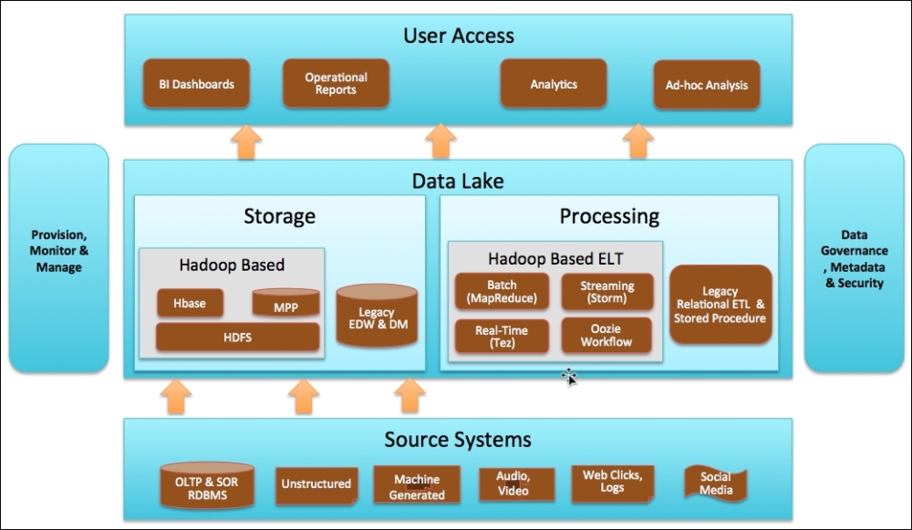

Slide 31
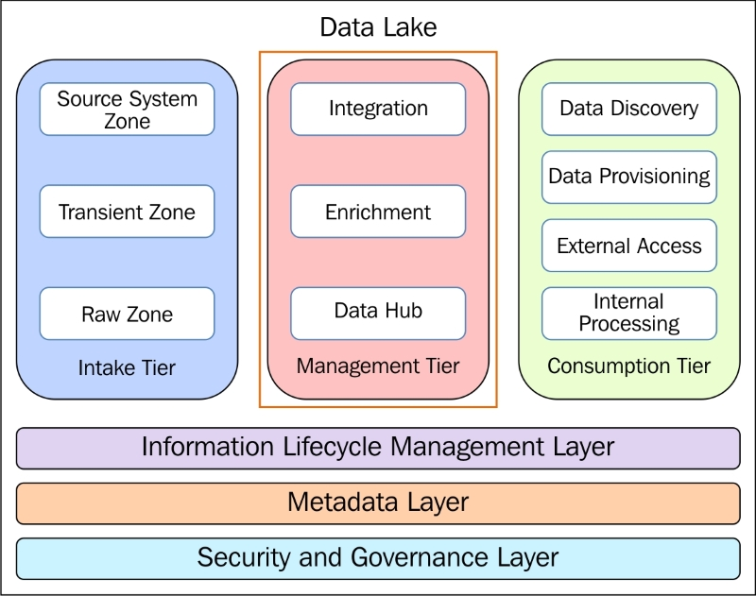
End-State Data Lake

Slide 32
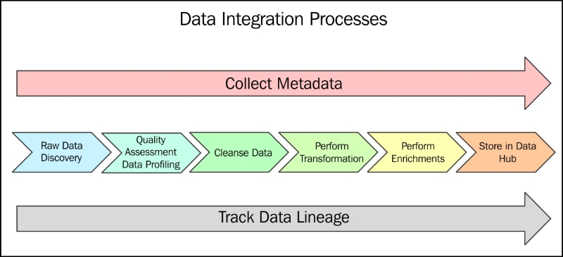

Slide 33
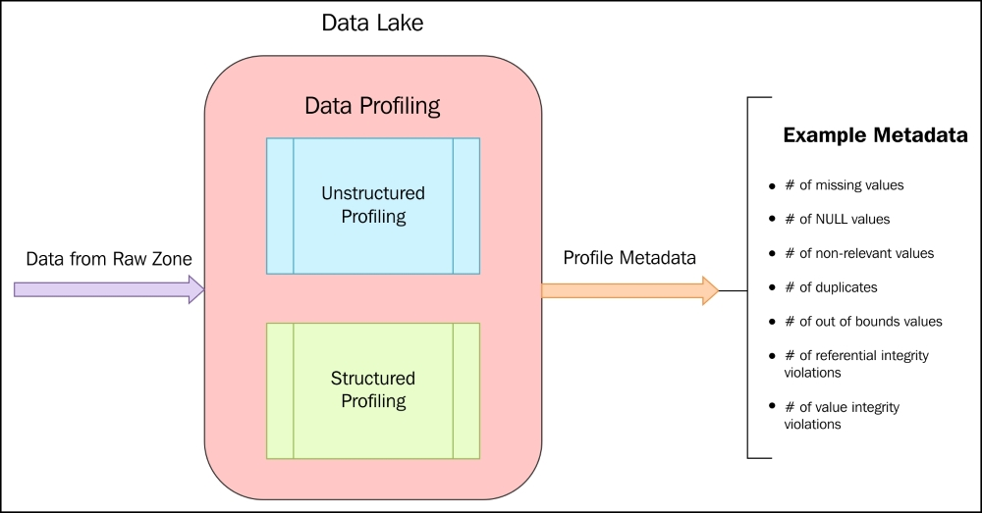

Slide 34
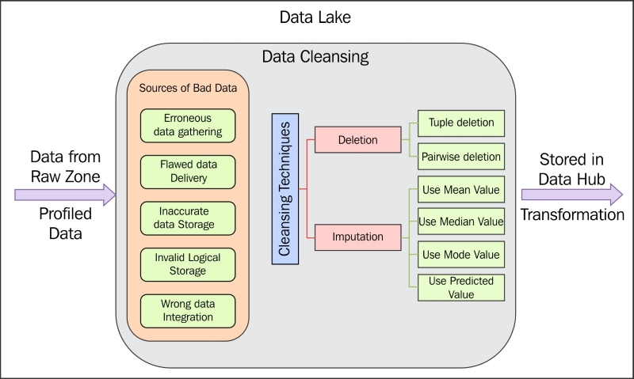

Slide 35
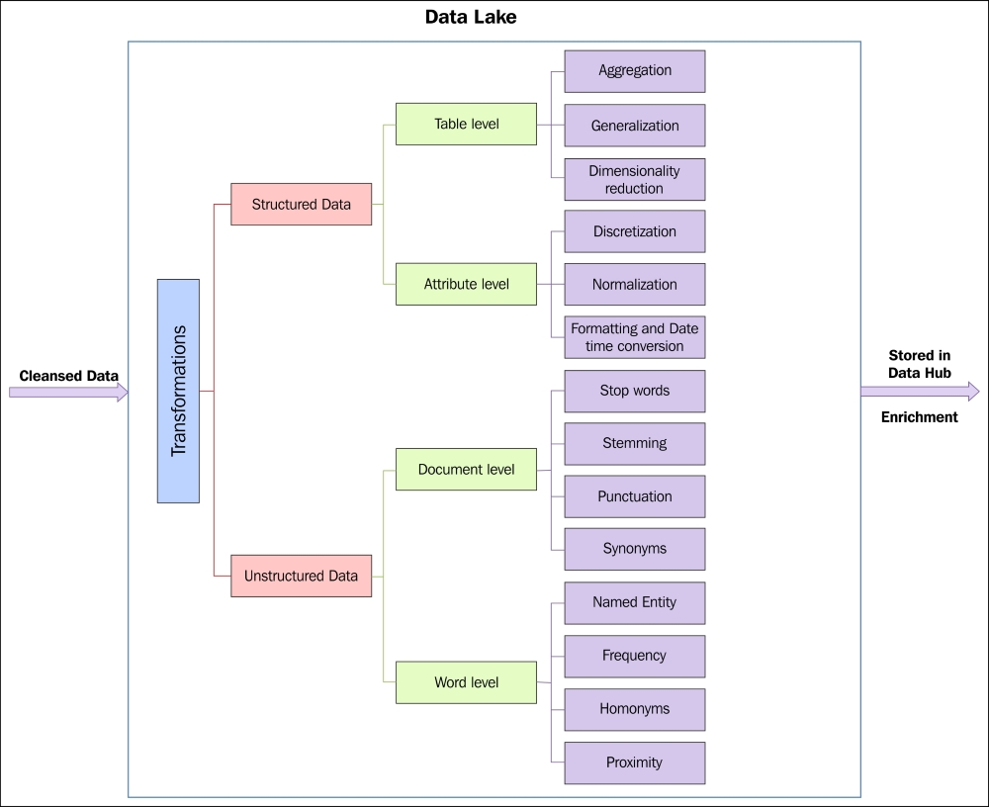

Slide 36
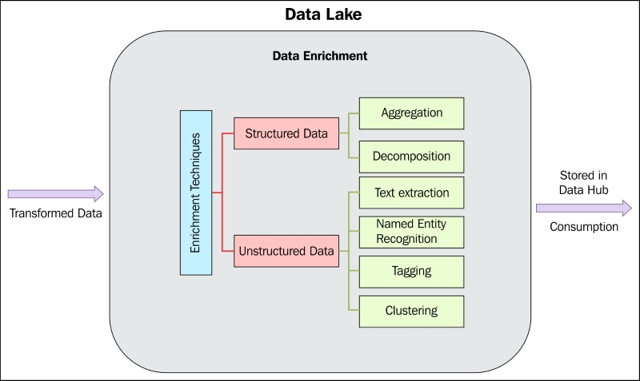

Slide 37
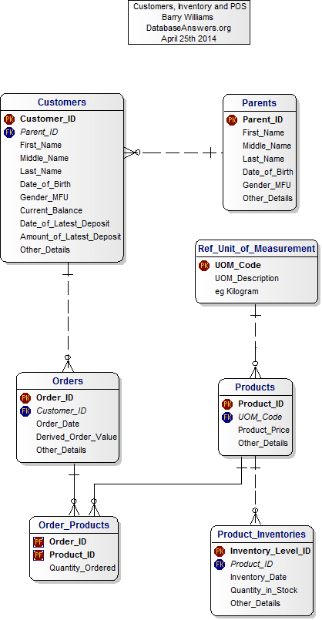

Slide 38
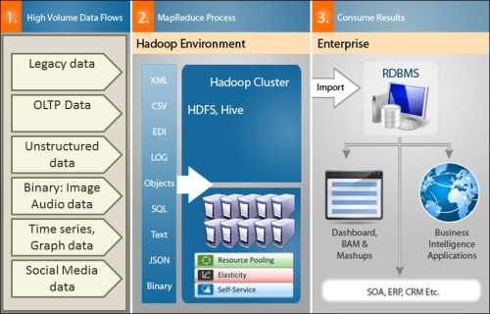
Data Integration Design Patterns
Ingress and Egress Design Patterns
Data Profiling Patterns
Data Transformation Patterns
Data Validation/Cleansing Pattern
Data Reduction Patterns

Slide 39
Data Integration
Ingress and Egress Design Patterns
Legacy data
OLTP data
Unstructured Data
Video/Audio/Images
Numerical/Patterns/Graphs
Social Media data

Slide 40
Data Integration
Data Profiling Patterns –
Data type Inference pattern
Statistical profiling pattern
Pattern-matching pattern
String profiling pattern
Unstructured text profiling pattern
Data Transformation Patterns –
Structured-to-hierarchical transformation pattern
Data Normalization pattern
Data Integration Pattern
Aggregation pattern
Data generalization pattern
CDC (change data capture) and SCD ( Slowly Changing Dimension)
Surrogate Key generation

Slide 41
Data Integration
Data Validation/Cleansing Pattern –
Constraint Validation and cleansing
RegEx validation and cleansing
Corrupt data validation and cleansing
Unstructured text data validation and Cleansing
Data Reduction Patterns –
Dimensionality reduction pattern
Numerosity reduction –sampling design pattern
Numerosity reduction –histogram design pattern
Numerosity reduction –clustering design pattern

Slide 42
Data Analysis
Create data marts for following subject areas–
Sales/Inventory/Returns Analysis
Promotion Analysis
Marketing Response Analysis
Web Sales Analysis

